Slide 1
Tools and Agents
https://thesequence.substack.com/p/the-sequence-opinion-552-seriously

Slide 2

Agents are Systems that Plan and Act
Perceive the environment
Decide on actions to pursue a goal
Execute actions

Slide 3
Agents are Systems that Plan and Act
Are persistent…
… and adaptable
Maintain internal goals and make decisions along the way

Slide 4
Agents are Systems that Plan and Act
Maintain internal goals and make decisions along the way
If obstacles arise: adapts plan

Slide 5
Agent architecture
LLM for reasoning:
Generates plans, decisions, and natural language
Memory: Tracks state across steps. Includes short-term (within session) and long-term (across sessions) memory.
Tools:
APIs, browsers, calculators, and other functions to gather information or act.
Execution loop:
Orchestrates LLM calls, tool use, and memory updates until a goal is reached.

Slide 6
Degrees of Autonomy
Co-pilots:
assist, but depend heavily on human input
Semi-autonomous agents:
can take a goal and execute sub-tasks independently
might draft reports or analyze data, then wait for feedback before continuing.
Balance automation with oversight.
Fully-autonomous agents:
operate with minimal or no human input.
set plans, execute steps, and decide when a task is complete.
resemble digital workers

Slide 7
Agent dynamics
Operate through dynamic decision trees: Each step depends on outcomes from the previous.
Plans evolve in real time.
Explore branches:
If plan A fails, they pivot to plan B.
They reason, observe, and adjust.
Navigate complex trees of possibility:
balance exploration and exploitation, making decisions under uncertainty
Think ahead and react:
balance exploration and exploitation, making decisions under uncertainty

Slide 8
Agents vs LLMs and functions
Function: input > output No thinking, adaptation, objectives
LLM: input > output No actions, no memory
Brain, not body
Agent: wraps around LLM and provides the structure: memory, tools, goals, execution loop

Slide 9
Agents vs Functions
Function: input > output is stateless
is single-purpose
lacks initiative
Agent: manages state
make decisions can operate continuously
can recover from failure, try alternatives, self-monitor progres can call functions, but are not functions themselved

Slide 10

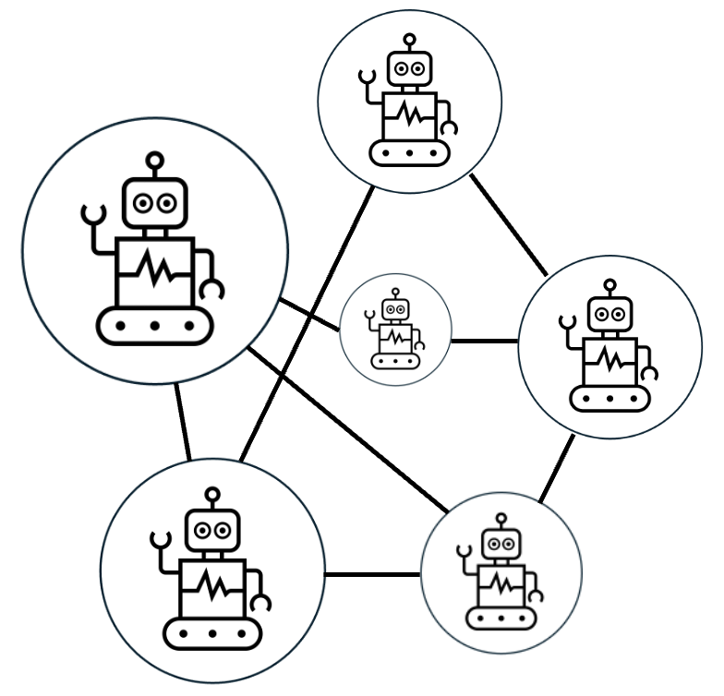


Tools
+
LLM
Agent
Agentic AI

